Slide 1
Besturingssystemen
I Architectuur van besturingssystemen (50%)
Perl (50%)
II Unix/Linux
    Interne werking (theorieles, 30%)
    Bash scripts (theorieles en labo, 30%)
    Programmeren systeemaanroepen (labo, 40%)
III Windows
    Theorie: beheer van Windows Server (30%)
    Programmeren van WMI scripts (40%)
    Programmeren van LDAP scripts (30%)

Slide 2
Windows NT
Workstation
Server
3.1, 3.5, 3.51
√
√
4.0
√
√
5.0
Windows 2000
Windows 2000 Server
5.1
Windows XP
×
5.2
×
Windows Server 2003
6.0
Windows Vista
Windows Server 2008
6.1
Windows 7
Windows Server 2008 R2
Windows Server 2012 ⁽R2⁾
6.²/₃
Windows 8/8.1
6.4
10.0
Windows 10
Windows Server 2016

Slide 3
WMI
basisarchitectuur: WMI versus SNMP
WMI klassen en objecten
WMI CIM Studio
Qualifiers
Associatorklassen
WMI Query Language (WQL)
Event providers versus interne polling
Notification queries (WbemTest)
Permanente Eventregistratie

Slide 4
WMI versus SNMP
NETWORK
MANAGEMENT
APPLICATION (NMA)
NETWORK MANAGEMENT
STATION (NMS)
MANAGER
GET / SET
EXTERNE POLLING
SCALAIRE
OBJECTEN
+
TABELLEN
MIB
AGENTEN

Slide 5
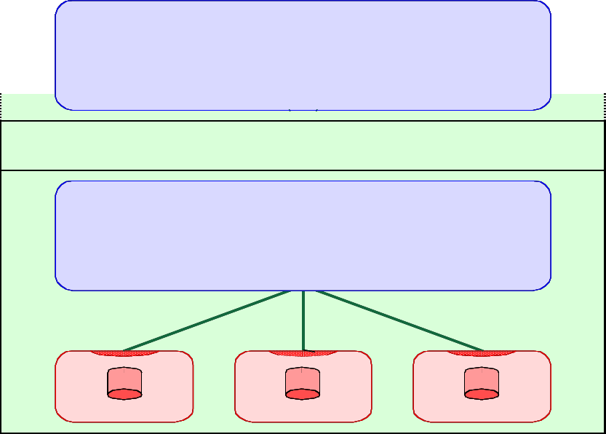
WMI versus SNMP
MANAGER
TRANSPORT
MASTER AGENT
SNMP COMMUNICATIE MET NMSs
STANDAARD UDP POORTEN 161 & 162
SNMP PROTOCOL
SPECIFIEK PROTOCOL
OF IPC MECHANISME
API
API
API
MIB
MIB
MIB
SUB AGENT
SUB AGENT
SUB AGENT

Slide 6
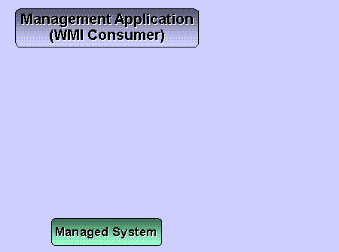
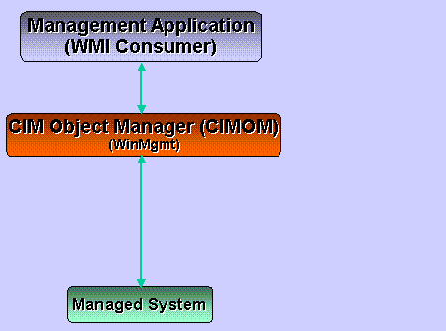
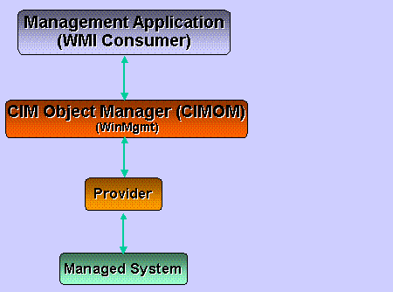
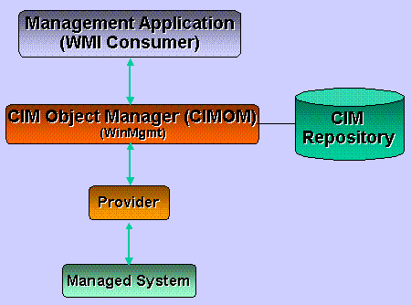
WMI basisarchitectuur

Slide 7
WMI
basisarchitectuur: WMI versus SNMP
WMI klassen en objecten
WMI CIM Studio
Qualifiers
Associatorklassen
WMI Query Language (WQL)
Event providers versus interne polling
Notification queries (WbemTest)
Permanente Eventregistratie

Slide 8
WMI
basisarchitectuur: WMI versus SNMP
WMI klassen en objecten
WMI CIM Studio
  aanvullende WMI Administrative Tools software vereist, te downloaden via http://www.microsoft.com/en-us/download/details.aspx?id=24045
  in Internet Explorer 10+ is het noodzakelijk om <META http-equiv="x-UA-Compatible" content="IE=8" /> in <HEAD> sectie toe te voegen
alternatieve browsers: Powershell WMI Browser
diverse WMI Explorer’s (sapien.com, ks-soft.com, codeplex.com, ...)

Slide 9
WMI Qualifiers
Klassequalifiers (objectqualifiers)
Attribuutqualifiers
Methodequalifiers
Methodeparameterqualifiers

Slide 10
WMI Qualifiers
Klassequalifiers (objectqualifiers)
Description
Abstract
Dynamic
Provider
Singleton
Association
Attribuutqualifiers
Methodequalifiers
Methodeparameterqualifiers
Notes:
Singleton: win32_currenttime
Provider: voor alle dynamic klassen

Slide 11
WMI Qualifiers
Klassequalifiers (objectqualifiers)
Attribuutqualifiers
Description
CIMType
Read en/of Write
Keys
ValueMap
Values
Template
Methodequalifiers
Methodeparameterqualifiers
Notes:
Keys
Win32_Environment (2): Name,UserName
Win32_IP4RouteTable (2): Destination,NextHop
Win32_StartupCommand (4): Command,Location,Name,User
Values zonder ValueMap
Win32_Thread ThreadState,ThreadWaitReason
Win32_Printer PaperSizesSupported,PrinterState, StatusInfo
Values met ValueMap
Win32_Share Type
Win32_PointingDevice DeviceInterface
Win32_Printer PrinterStatus,StatusInfo

Slide 12
WMI Qualifiers
Klassequalifiers (objectqualifiers)
Attribuutqualifiers
Methodequalifiers
Description
CIMType
ValueMap
Values
Privileges
Static
Methodeparameterqualifiers
Notes:
Values
Win32_Process (6): Create,Terminate
Win32_Service (10): StartService,StopService
Win32_Share (3): Create,Delete
Win32_OperatingSystem (4): Win32Shutdown,SetDateTime
Win32_Volume (9): Chkdsk,Format,Defrag
Win32_NetworkAdapterConfiguration (41): RenewDHCPLeaseAll,SetDefaultTTL
Static
Win32_Process, Win32_Share Create
Win32_PrinterDriver (1): AddPrinterDriver
Win32_NetworkAdapterConfiguration RenewDHCPLeaseAll, SetDefaultTTL
Privileges
Win32_Process Create {(AssignPrimaryToken,IncreaseQuota,Restore)}!
Terminate {(Debug)}!
Win32_OperatingSystem Reboot,Shutdown,RemoteShutdown {(Shutdown)}!
SetDateTime {(SystemTime)}!

Slide 13
WMI Qualifiers
Klassequalifiers (objectqualifiers)
Attribuutqualifiers
Methodequalifiers
Methodeparameterqualifiers
Description
CIMType
ValueMap
Values
Out
Optional
ID
Notes:
*optional #values
Win32_Share Create Path(0),Name(1),Type(2)#,MaximumAllowed(3)*,Description(4)*,Password(5)*,Access(6)*
Out
Win32_Process Create ProcessId(3),ReturnValue
GetOwnerSid ReturnValue,Sid(0)
Win32_Volume Defrag DefragAnalysis(1),ReturnValue

Slide 14
WMI
basisarchitectuur: WMI versus SNMP
WMI klassen en objecten
WMI CIM Studio
Qualifiers
Associatorklassen
WMI Query Language (WQL)
Event providers versus interne polling
Notification queries (WbemTest)
Permanente Eventregistratie
Notes:
Ook met attributen: Win32_VolumeUserQuota
Recursieve
Win32_Directory via Win32_SubDirectory (GroupComponent,PartComponent)
Win32_BaseService via Win32_DependentService (Antecedent,Dependent)

Slide 15
WMI Query Language (WQL)
SELECT ... FROM klasse [ WHERE ... ]
REFERENCES OF {…} [ WHERE ... ]
ASSOCIATORS OF {…} [ WHERE ... ]
  AssocClass = klassenaam
  ResultClass = klassenaam
  ResultRole = sleutelattribuutnaam
  Role = sleutelattribuutnaam
  ClassDefsOnly
Schemaqueries
  SELECT * FROM meta_class [ WHERE ... ]
  ASSOCIATORS OF {…} WHERE schemaonly
Notes:
select * from win32_networkadapter
where netconnectionid like 'eth%'
select * from cim_datafile
where drive='c:' and path='\\windows\\system32\\'
and lastmodified > '20070901'
associators of {Win32_Directory.Name="C:\\emacs\\etc"}
submappen where resultclass = win32_directory role = groupcomponent
oudermap where resultclass = win32_directory role =partcomponent
bestanden where resultclass = cim_datafile
SELECT * FROM meta_class
WHERE __class = 'CIM_Service’
WHERE __superclass = 'CIM_Service’
WHERE __this isa 'CIM_Service' AND __class != 'CIM_Service'
WHERE __superclass IS null

Slide 16
SNMP
NETWORK
MANAGEMENT
APPLICATION (NMA)
NETWORK MANAGEMENT
STATION (NMS)
MANAGER
GET / SET
EXTERNE POLLING
TRAP
SCALAIRE
OBJECTEN
+
TABELLEN
MIB
AGENTEN

Slide 17
WMI basisarchitectuur

Slide 18
WMI Event Providers
ideaal scenario:
  consumers registreren (cfr. notification query) condities waarin men geïnteresseerd is
  event providers creëren event objecten in repository van zodra condities optreden
  consumers hierdoor onmiddellijk geactiveerd

Slide 19
WMI
basisarchitectuur: WMI versus SNMP
WMI klassen en objecten
WMI CIM Studio
Qualifiers
Associatorklassen
WMI Query Language (WQL)
Event providers versus interne polling
Notification queries (WbemTest)
Permanente Eventregistratie
Notes:
SELECT * FROM __InstanceCreationEvent
where targetinstance isa 'win32_ntlogevent'
and targetinstance.logfile = 'system‘
and targetinstance.eventtype = 1
group within 60 by targetinstance.eventcode
SELECT * FROM __InstanceCreationEvent within 5
where targetinstance isa 'win32_process'
and targetinstance.name = 'notepad.exe‘

Slide 20
WMI Event Providers
ideaal scenario:
  consumers registreren (cfr. notification query) condities waarin men geïnteresseerd is
  event providers creëren event objecten in repository van zodra condities optreden
  consumers hierdoor onmiddellijk geactiveerd
probleem: weinig providers zijn eveneens event providers

Slide 21
Event Polling
tussenoplossing: CIMOM interne polling
  WMI service ondervraagt periodiek specifieke klassen bij de corresponderende providers
  PreviousInstance en TargetInstance snapshots
  WMI service creëert event objecten in repository van zodra condities optreden
externe polling door consumer
  verslindt bandbreedte en processorcycli
  bovendien opletten met caching door CIMOM: opfrissen noodzakelijk !

Slide 22
Permanente Eventregistratie
periodieke eventgenerator
standaard eventconsumers
  LogFileEventConsumer
  NTEventLogEventConsumer
  SMTPEventConsumer.
  CommandLineEventConsumer
  ActiveScriptEventConsumer

Slide 23
Permanente Eventregistratie
configuratie via drie objecten:
  __EventFilter object (WQL Query)
  __EventConsumer object
  o.a. via templates verwijzend naar informatie van het object dat het event veroorzaakt heeft:
    %__SERVER%
    %TargetInstance.Name%
    %NumberOfEvents%
    %Representative.TargetInstance.Name%
    ...
  __FilterToConsumerBinding object
Notes:
configuratie nieuw __EventFilter object
Name -> test
QueryLanguage -> WQL
Query -> SELECT * FROM __TimerEvent where TimerID = 'test'
configuratie nieuw CommandLineEventConsumer object
Name -> test
CommandLineTemplate -> C:\WINDOWS\system32\taskkill.exe /f /pid %TargetInstance.ProcessId%
configuratie nieuw SMTPEventConsumer object
Name -> test
FromLine -> ...@student.hogent.be
ToLine -> marleen.denert@hogent.be;joris.moreau@hogent.be
Subject -> %TargetInstance.Caption% started on %__SERVER%
SMTPServer -> mail-out.hogent.be

